Slide 1
Dynamic Classification of Eye Tracking Movements: Usage and Ranking
By Josef Krivan

Slide 2
Eye-Tracking
Has had major focus and development over the years
Many challenges come with the technology
Several important application areas, old and new

Slide 3
The Eye
A complex organ
Identifying objects and visually distinct entities
How we focus our eyes
Why our eyes are important

Slide 4
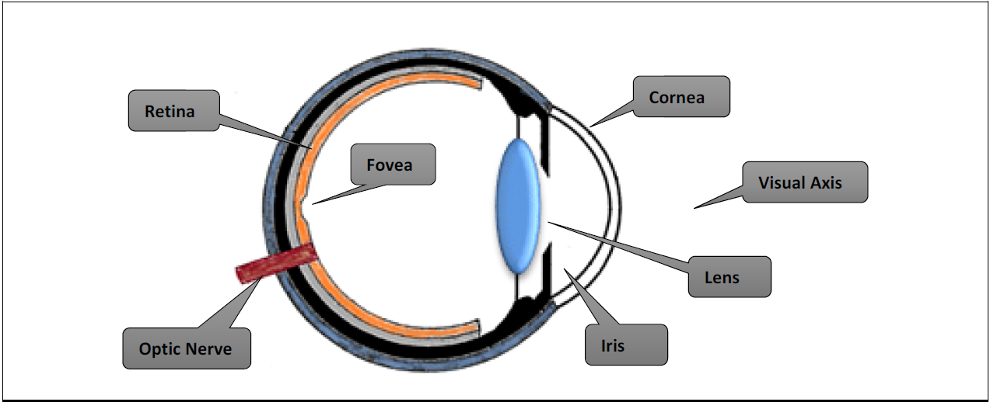
The Eye
Mathematics or Science?

Slide 5
Eye Data Process
Raw data
Data processing
Applying algorithms
Data presentation (textual or visualised)

Slide 6
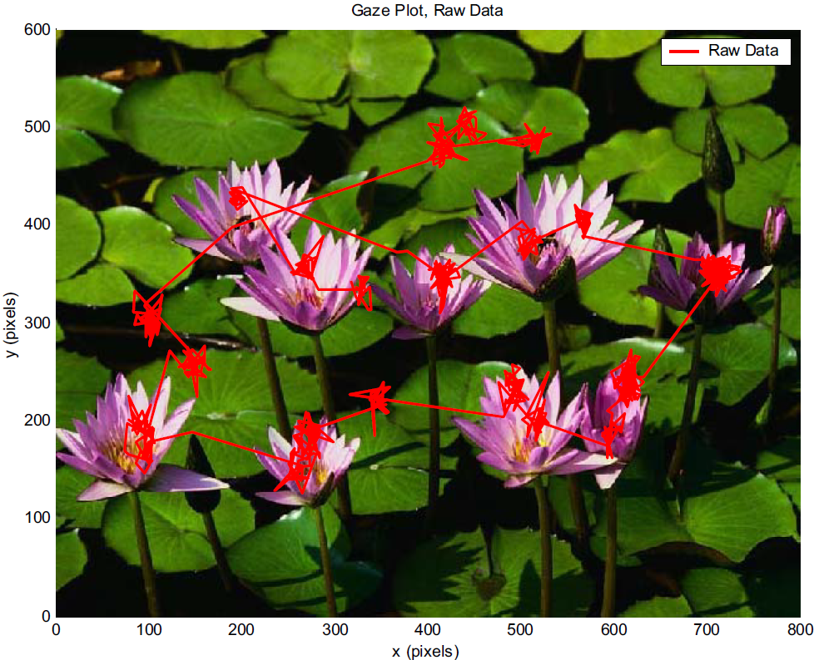
Eye-Tracker Data
Different classification methods

Slide 7
What We Currently Have
Existing eye-tracking application areas
Focus on certain eye-tracker data
Algorithms for data classification
Automated vs. manual detection of features

Slide 8
Eye Movement Features
Fixations
Saccades
Smooth pursuits
Lost data (Blinks, noise etc..)

Slide 9
Velocity-Based Algorithms
Based on a calculated velocity threshold
Identification via Velocity Threshold
Identification via Hidden Markov Model
Binocular-Individual Threshold
Nyström & Holmqvist / Larsson, Nyström & Stridh

Slide 10
Dispersion-Based Algorithms
Based on a dispersion threshold from an origin point
Identification via Dispersion Threshold
Covariance via Fixation Dispersion Threshold
Identification via Minimum Spanning Tree

Slide 11
Area-Based Algorithms
Based on (pre) determined areas of interest
Usually combined with a learning process
Identification via Area of Interest

Slide 12
Other Algorithms
Combined algorithms
Identification via Kalman Filter
Combines velocity and positional based algorithms

Slide 13
Methodology
Collecting the raw data
Process data for contextual use
Observe original results
Implement seperation algorithms
Compare results

Slide 14
Data Collection
Data from Samip Bhurtel
Using the Tobii eye-tracker
Data taken from one participant only
Fixation and saccade characterisation

Slide 15
Original Data Observations
Using the built-in Tobii algorithm
Quantitative comparisons of the features
Comparisons over time (duration)
Angle, Velocity, Acceleration distinctions

Slide 16
Original Data Observations (cont.)
Some visual comparisons (fixations and saccades)

Slide 17
I-VT Implementation
Calculating point-to-point distances
Calculate velocity with respect to timestamps between values
Use basic point-to-point velocities to establish threshold
Apply to the dataset, using threshold to seperate features

Slide 18
I-AVT Implementation
Builds ontop of the basic existing I-VT algorithm
Incorperates cosine angle between vectors for relative velocity
Apply cosine to earlier velocity calculations
Establish new thresholds (both positive and negative values)

Slide 19
I-DT Implementation
Set initial duration and proximity thresholds
Set start point
Check if each subsequent point is within boundaries, then within duration
If criteria is met once outside boundaries, mark previous as fixations
Compute the centroid point from prior set of fixation-classified points

Slide 20
Resulting Tables
Tables consisting of position and time inputs
Side-by-side comparison of feature classification
Hamming distance
Eye-tracker algorithm vs. implementations

Slide 21
The K-Ratio
Categorising which algorithms work best
The lower the k-value, the better the threshold
Improves comparisons against the baseline
Does not guarantee completeness

Slide 22
Results

Slide 23
Results (K-Ratio)

Slide 24
Cont...

Slide 25
Results (I-VT)

Slide 26
Cont...

Slide 27
Results (I-AVT)

Slide 28
Cont...

Slide 29
Results (I-DT)

Slide 30
Cont...

Slide 31
Combined Results

Slide 32
Cont...

Slide 33
Cont...2

Slide 34
Evaluation of the Algorithms

Slide 35
Discussion

Slide 36
Conclusions

Slide 37
Future Work

Slide 38
Thank You

